Slide 1
Functional annotation – interpret your data! (a.k.a gene-set analysis)
Leif Wigge
leif.wigge@scilifelab.se
SciLifeLab National Bioinformatics Infrastructure, Long-term Support (WABI)
Chalmers Computational Systems Biology Infrastructure (CSB)
www.nbis.se

Slide 2
Outline
Gene-set analysis - What and why?
Gene-set collections
Methods for GSA
Gene-set directionality, overlap/interactions, biases
Things to consider
Will try to be practical, without getting to the detail of code-level

Slide 3
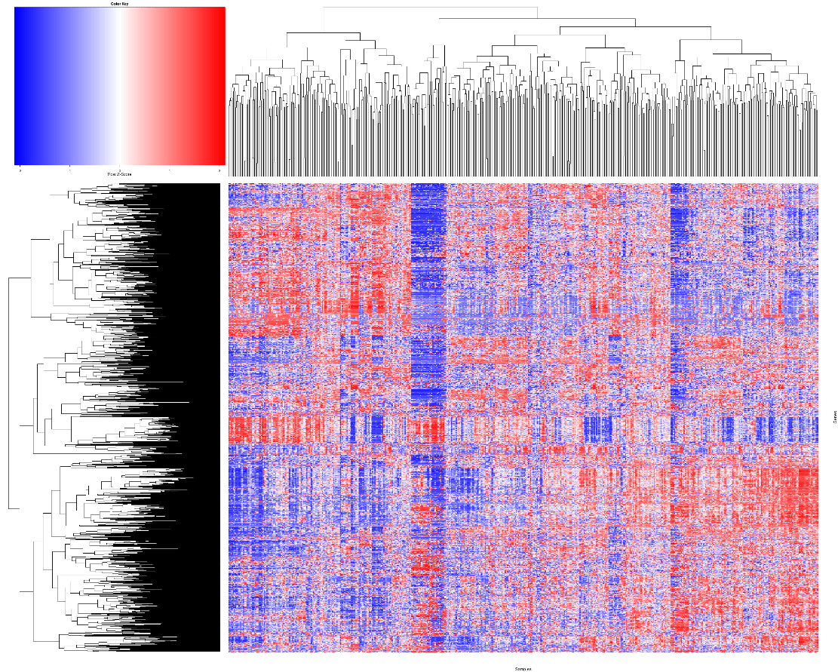


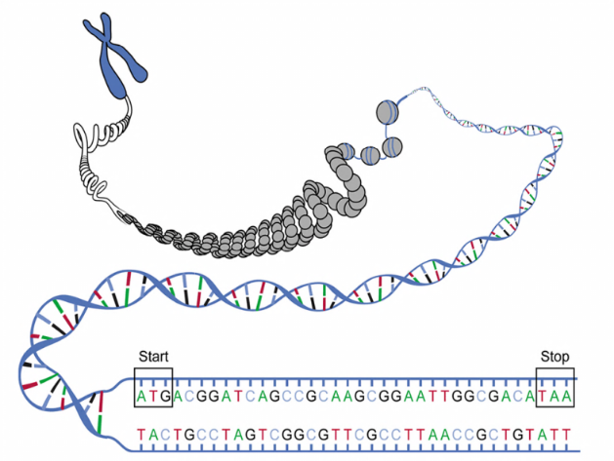
What is gene-set analysis (GSA)?
Samples
Immune response
Genes
Pyruvate
PPARG
GO-terms
Pathways
Chromosomal locations
Transcription factors
Histone modifications
Diseases
etc…
Gene-set analysis
Gene-level data
Gene-set data (results)
We will focus on transcriptomics and differential expression analysis
However, GSA can in principle be used on all types of genome-wide data.

Slide 4
Many names for gene-set analysis (GSA)
Functional annotation
Pathway analysis
Gene-set enrichment analysis
GO-term analysis
Gene list enrichment analysis
…

Slide 5
Examples
Images sources: Garg et al. Sci Rep 5 (2015); Gutteridge et al. PLoS ONE 8 (2013); Han et al. BMC Genomics 15 (2014)

Slide 6
Why gene-set analysis (GSA)?
Interpretation of genome-wide results
Gene-sets are (typically) fewer than all the genes and have more descriptive names
Difficult to manage a long list of significant genes
Detect patterns that would be difficult to discern simply by manually going through e.g. the list of differentially expressed genes
Integrates external information into the analysis
Less prone to false-positives on the gene-level
Top genes might not be the interesting ones, several coordinated smaller changes
Notes:
9 min

Slide 7
Gene-sets

Slide 8
So what about gene-sets?
Depends on the research question
Several databases/resources available providing gene-set collections (e.g. MSigDB, Enrichr)
Included directly in some analysis tools
GO-terms are probably one of the most widely used gene-sets
GO-terms
Pathways
Chromosomal locations
Transcription factors
Histone modifications
Diseases
Metabolites
etc…

Slide 9
Gene-set example: Gene ontology (GO) terms
Hierarchical graph with three categories (or parents): Biological process, Molecular function, Cellular compartment
Terms get more and more detailed moving down the hierarchy
Genes can belong to multiple GO terms

Slide 10
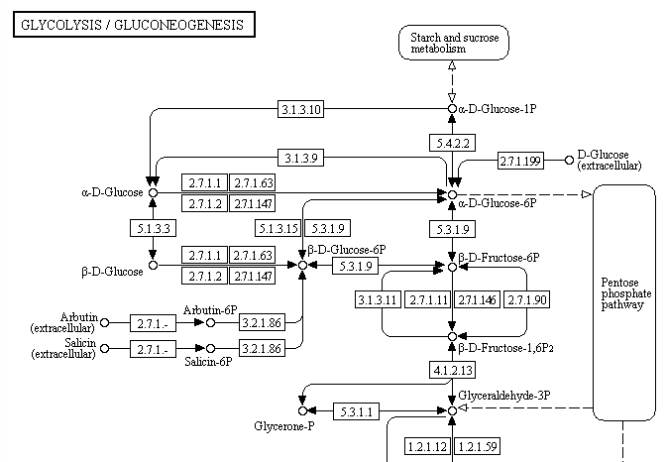
Gene-set example: Metabolic pathways or metabolites

Slide 11
Gene-set example: Transcription factor targets

Slide 12
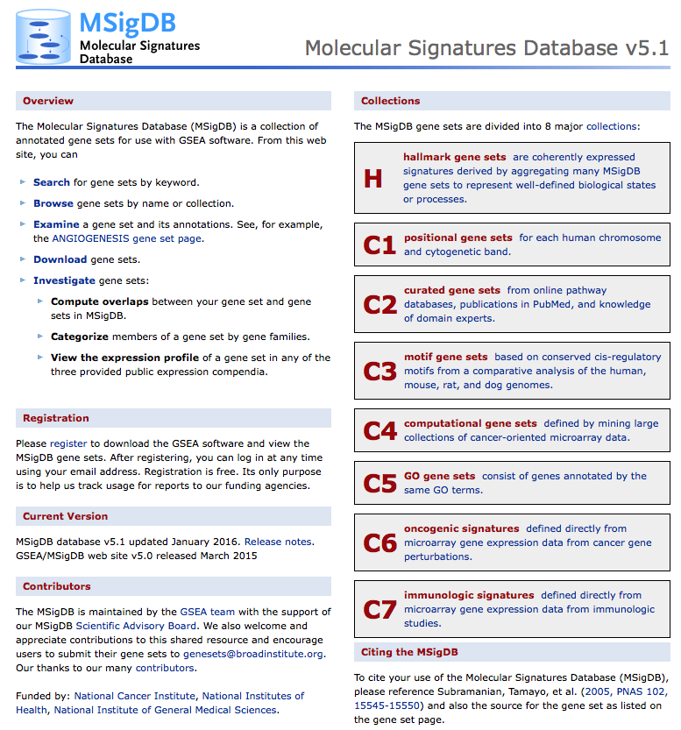
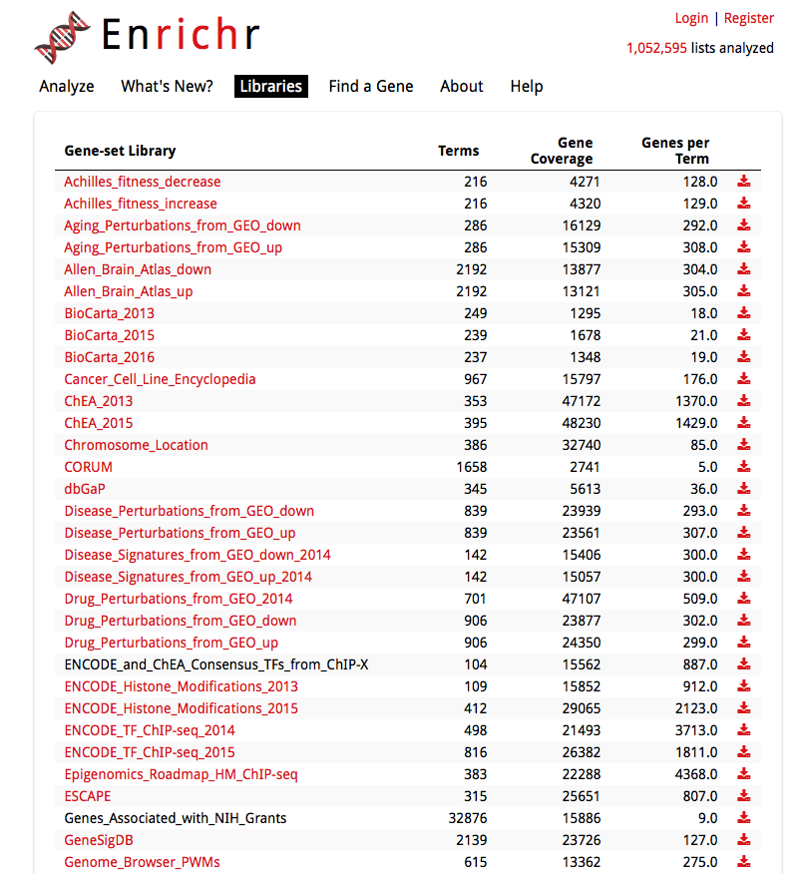
Where to get gene-set collections?
http://software.broadinstitute.org/gsea/msigdb/index.jsp
http://amp.pharm.mssm.edu/Enrichr/#stats
Parsed info from various databases. Focus on human.

Slide 13
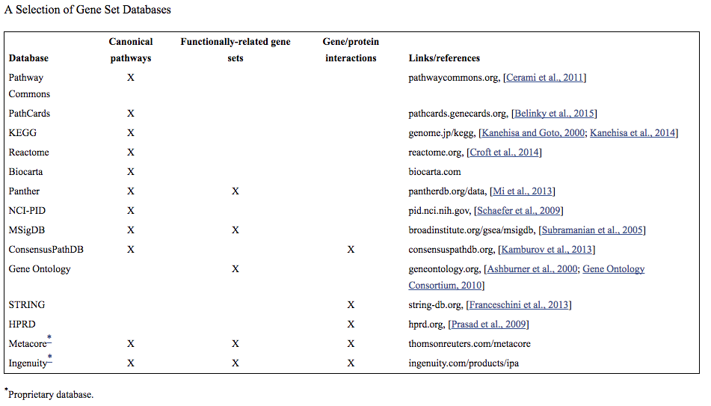
Where to get gene-set collections?
Not working with human data?
doi: 10.1002/ajmg.b.32328
GO annotations for many species http://geneontology.org/page/download-annotations
clusterProfiler (R/Bioconductor package) http://bioconductor.org/packages/devel/bioc/vignettes/clusterProfiler/inst/doc/clusterProfiler.html#go-gene-set-enrichment-analysis
Notes:
18min

Slide 14
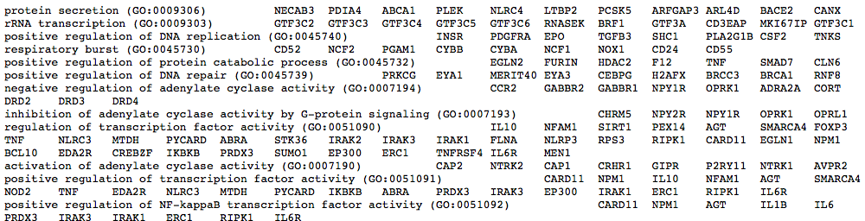
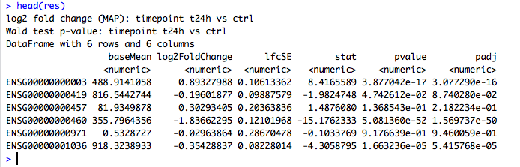
Where to get gene-set collections?
Sooner or later you will run into the problem of matching your data to gene-set collections due to the existence of several gene ID types

Slide 15
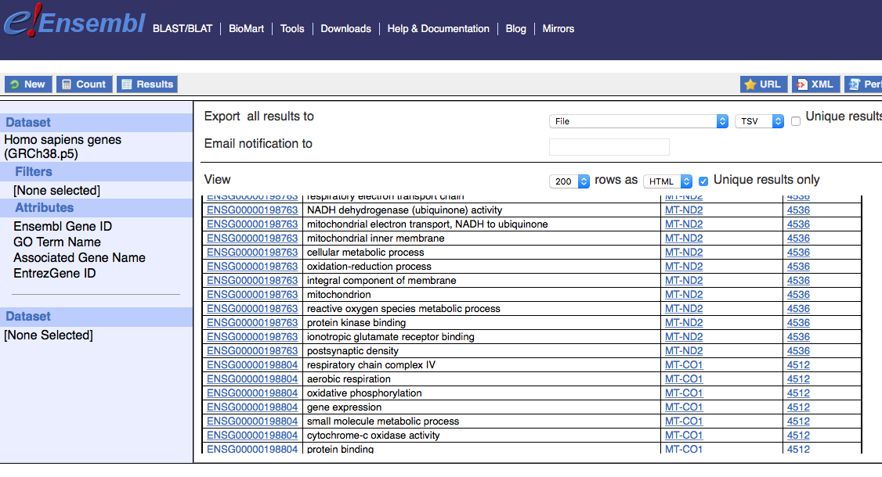
Where to get gene-set collections?
http://www.ensembl.org/biomart/martview
One way to map different gene IDs to each other, or to assemble a gene-set collection with the gene IDs used by your data
See also:
DAVID https://david.ncifcrf.gov/content.jsp?file=conversion.html
Mygene http://mygene.info/ and http://bioconductor.org/packages/release/bioc/html/mygene.html
Notes:
20 min

Slide 16
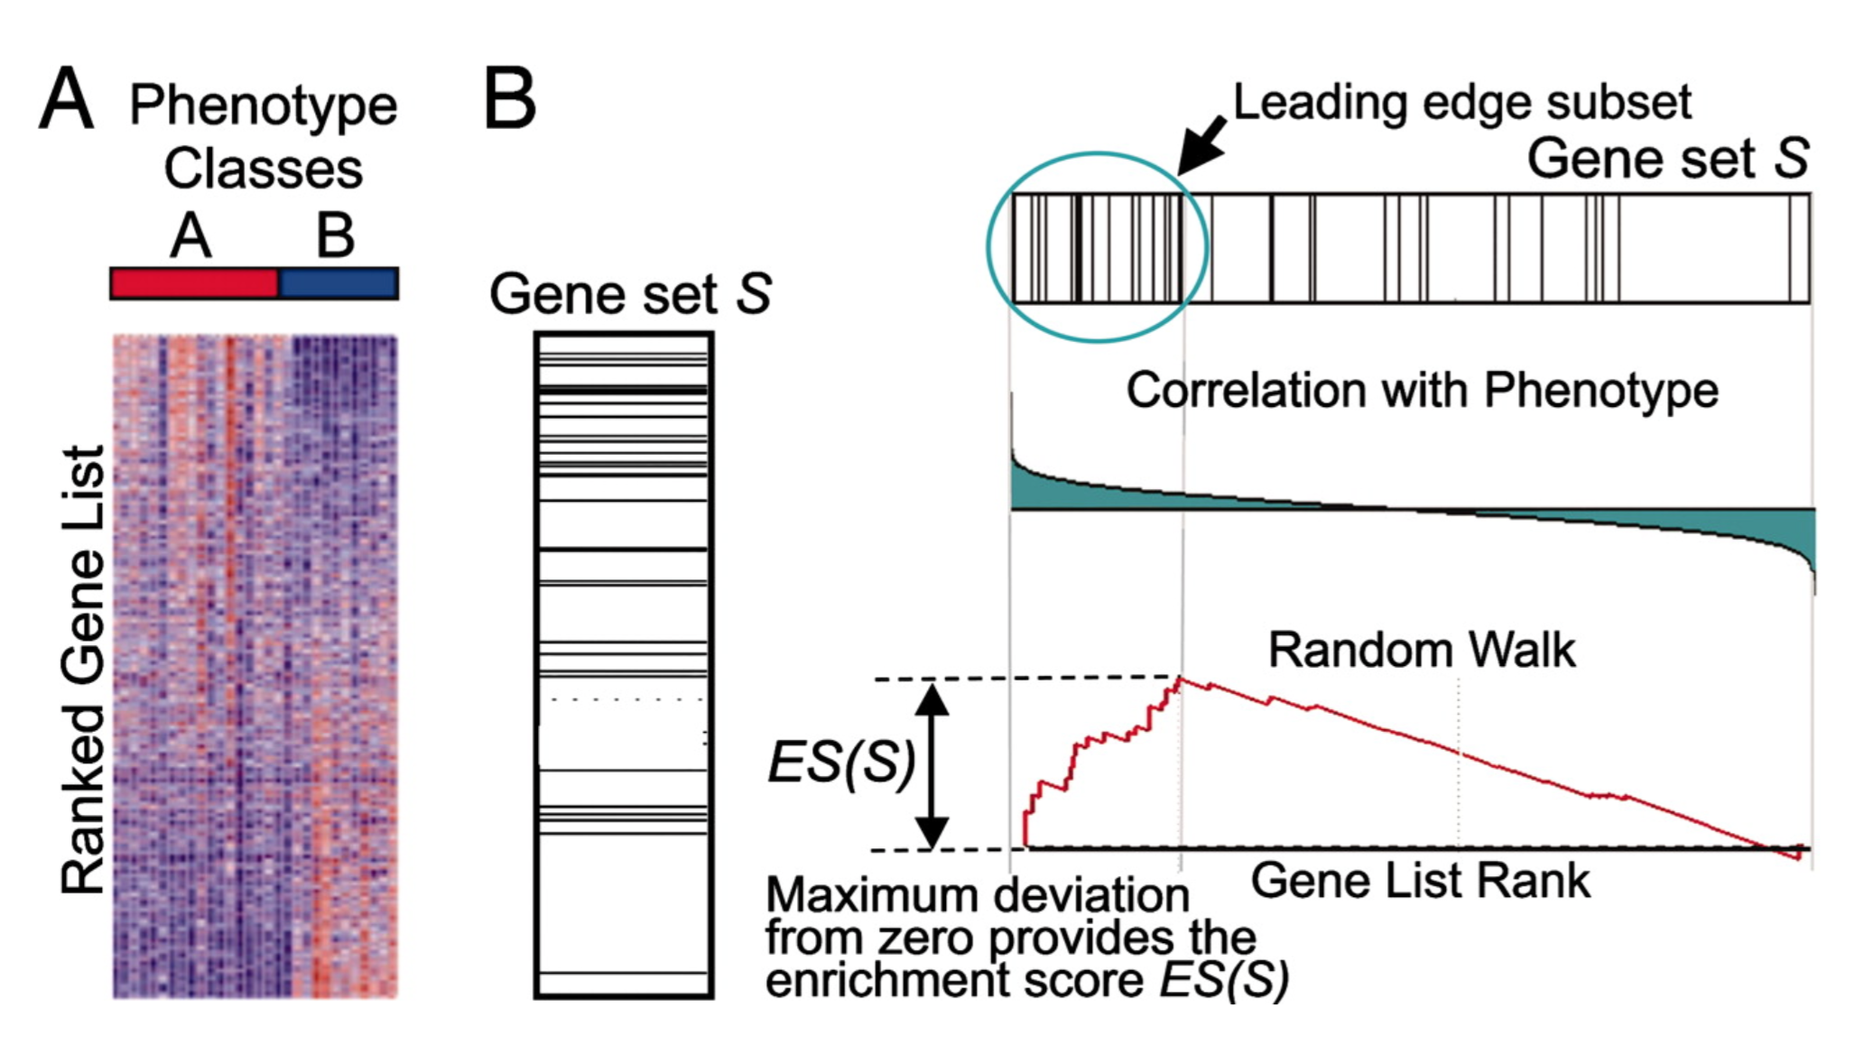
Gene-set analysis tools and methods

Slide 17
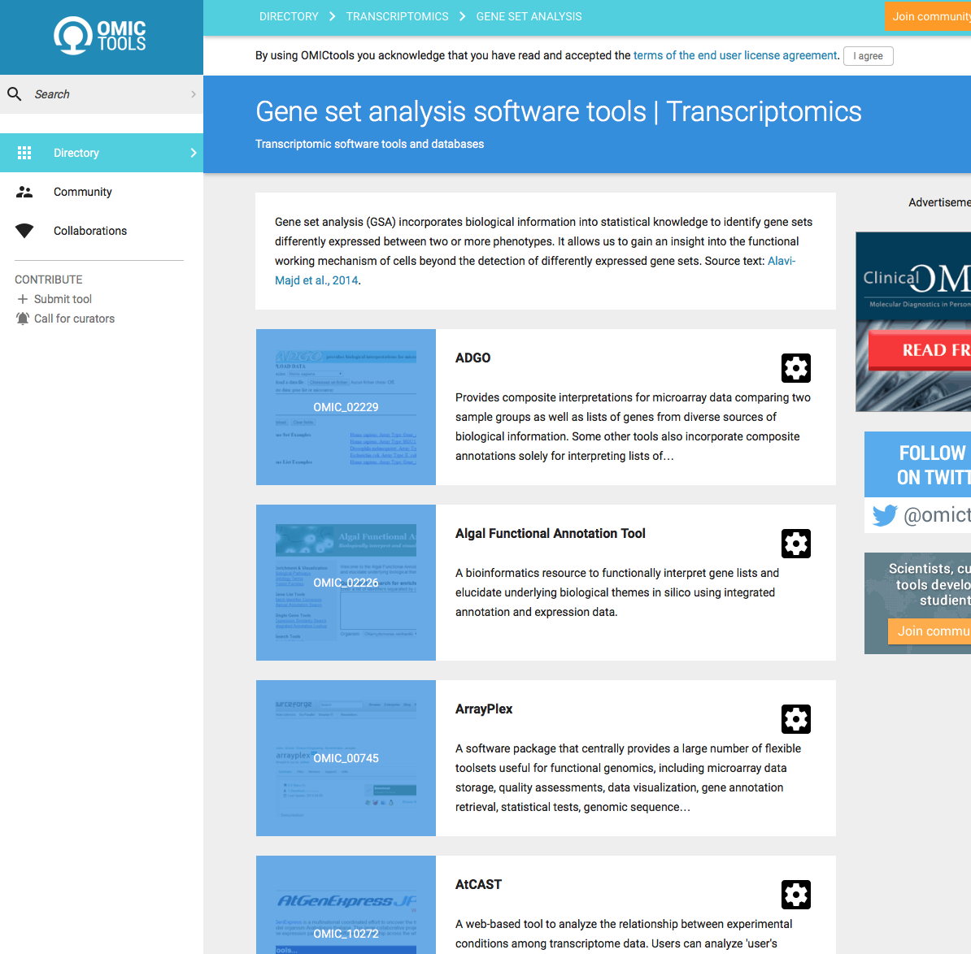
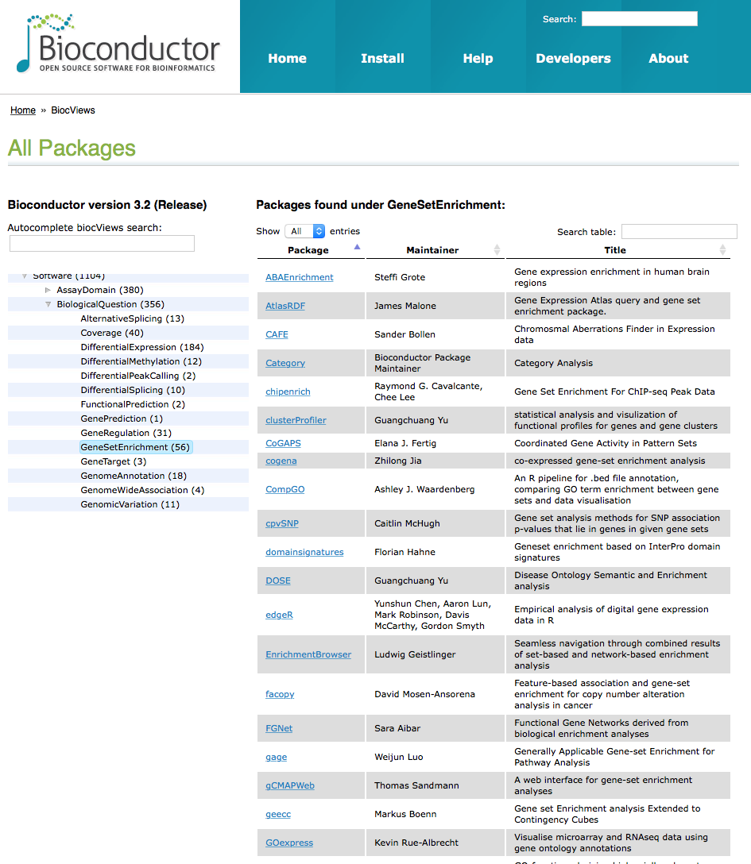
Tools and methods for GSA
There are hundreds of tools to choose between…
OmicsTools (several platforms)
http://omictools.com/gene-set-analysis-category
Bioconductor (R packages)
https://bioconductor.org/packages/release/BiocViews.html#___GeneSetEnrichment
Some examples:
Hypergeometric test / Fisher’s exact test (a.k.a overrepresentation analysis)
DAVID (browser)
Enrichr (browser)
GSEA (Java, R)
piano (R)
Also exists e.g.:
GSA for GWAS, miRNA, …
Network-based
PlantGSEA
GSA controlling for length bias in RNA-seq
…
Notes:
21 min

Slide 18
Overrepresentation analysis
Hypergeometric test
(Fisher’s exact test)
Is this overlap bigger than expected by random chance?
Selected Not selected
In GO-term
Not in GO-term
8 | 2
92 | 19768
All genes (universe)
GO:000237
Selected list of genes
GO:002736
GO:003478
GO:009835

Slide 19
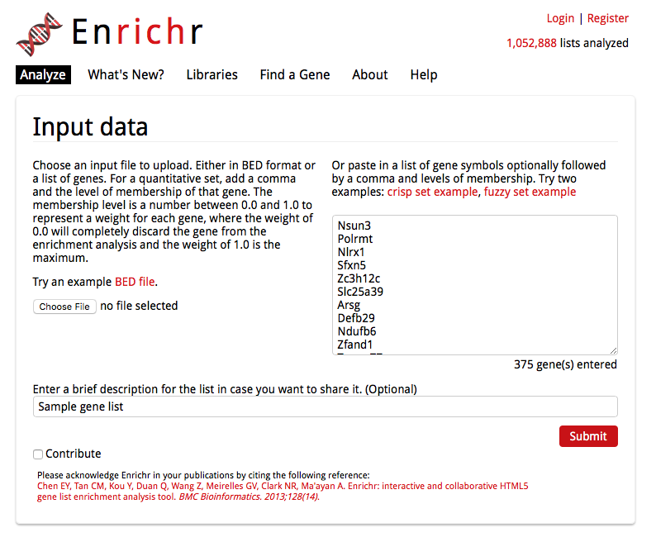
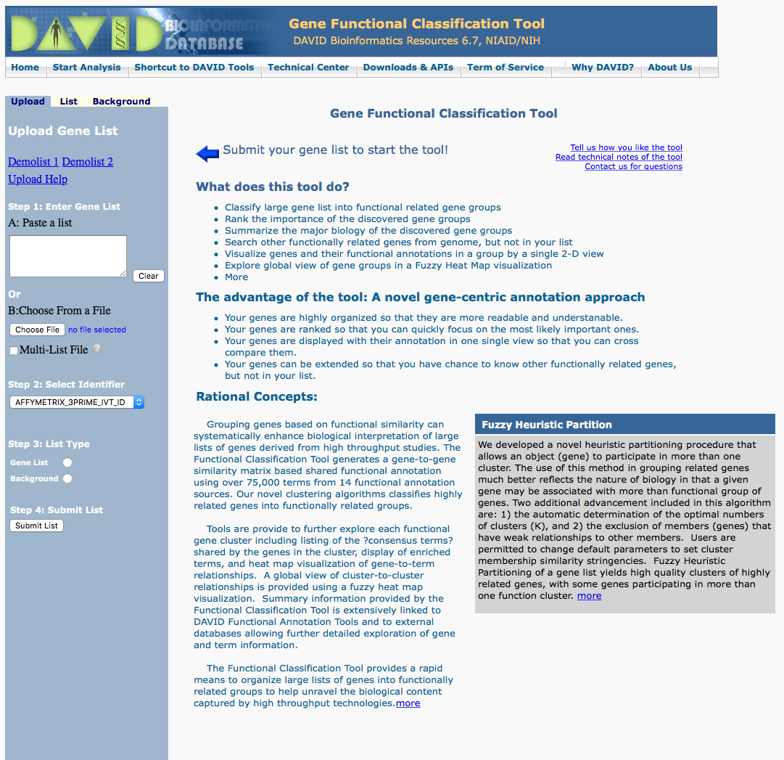
Overrepresentation analysis
http://amp.pharm.mssm.edu/Enrichr/
https://david.ncifcrf.gov/

Slide 20
Overrepresentation analysis
Selected Not selected
In GO-term
Not in GO-term
8 | 2
92 | 19768
Requires a cutoff (arbitrary)
Omits the actual values of the gene-level statistics
Good for e.g. overlap of significant genes in two comparisons
Computationally fast
In contrast, gene-set analysis is cutoff-free and uses all gene-level data and can detect small but coordinate changes that collectively contribute to some biological process.
A vs ctrl
B vs ctrl
13
114
45
Notes:
26 min

Slide 21
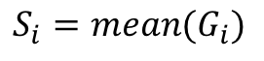
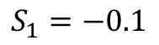
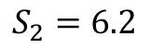
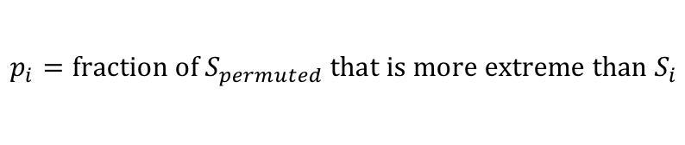
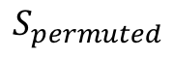
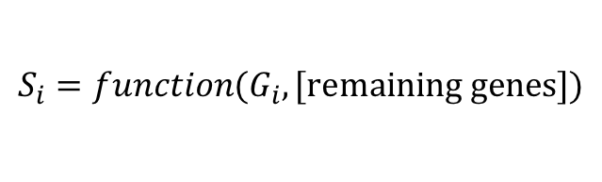
GSA: a simple example
$$S_{permuted}$$
S is the gene-set statistic
G are gene-level statistics of the genes in the gene-set
$$S_{i}=function(G_{i}, \text{[}\text{remaining} \text{genes}\text{]})$$
-6 0 6
$$S_{i}=mean(G_{i})$$
Samples
Gene-set 1
$$S_{1}=−0.1$$
Genes
Gene-set 2
$$S_{2}=6.2$$
Permute the gene-labels (or sample labels) and redo the calculations over and over again (e.g. 10,000 times)!
$$p_{i}=\text{fraction} \text{of} S_{permuted} \text{that} \text{is} \text{more} \text{extreme} \text{than} S_{i}$$
Notes:
27 min

Slide 22
Gene-level statistics
p-values
t-values, etc
Fold-changes
Ranks
Correlations
Signal to noise ratio
…

Slide 23
GSEA
Mootha et al Nature Genetics, 2003; Subramanian PNAS 2005

Slide 24
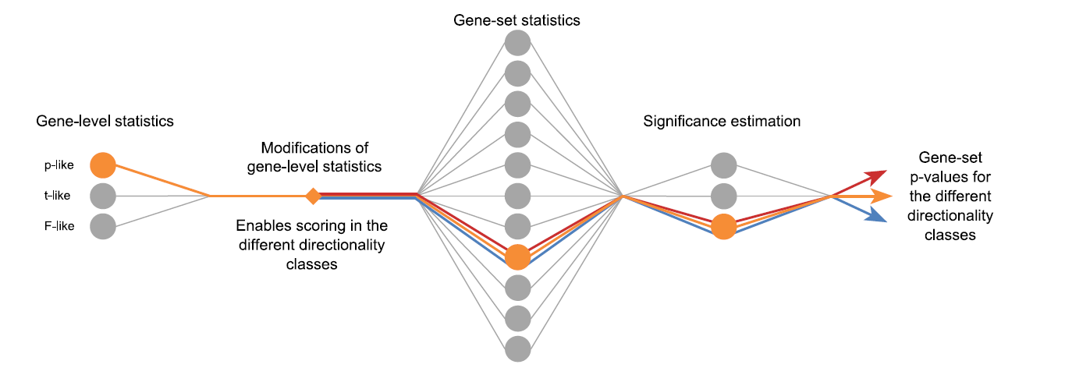
Piano – a platform for GSA (in R)
Reporter features
Parametric analysis of gene-set enrichment, PAGE
Tail strength
Wilcoxon rank-sum test
Gene-set enrichment analysis, GSEA (two implementations)
Mean
Median
Sum
Maxmean
Consensus
result
Disclaimer: The author of this presentation is the developer of piano

Slide 25
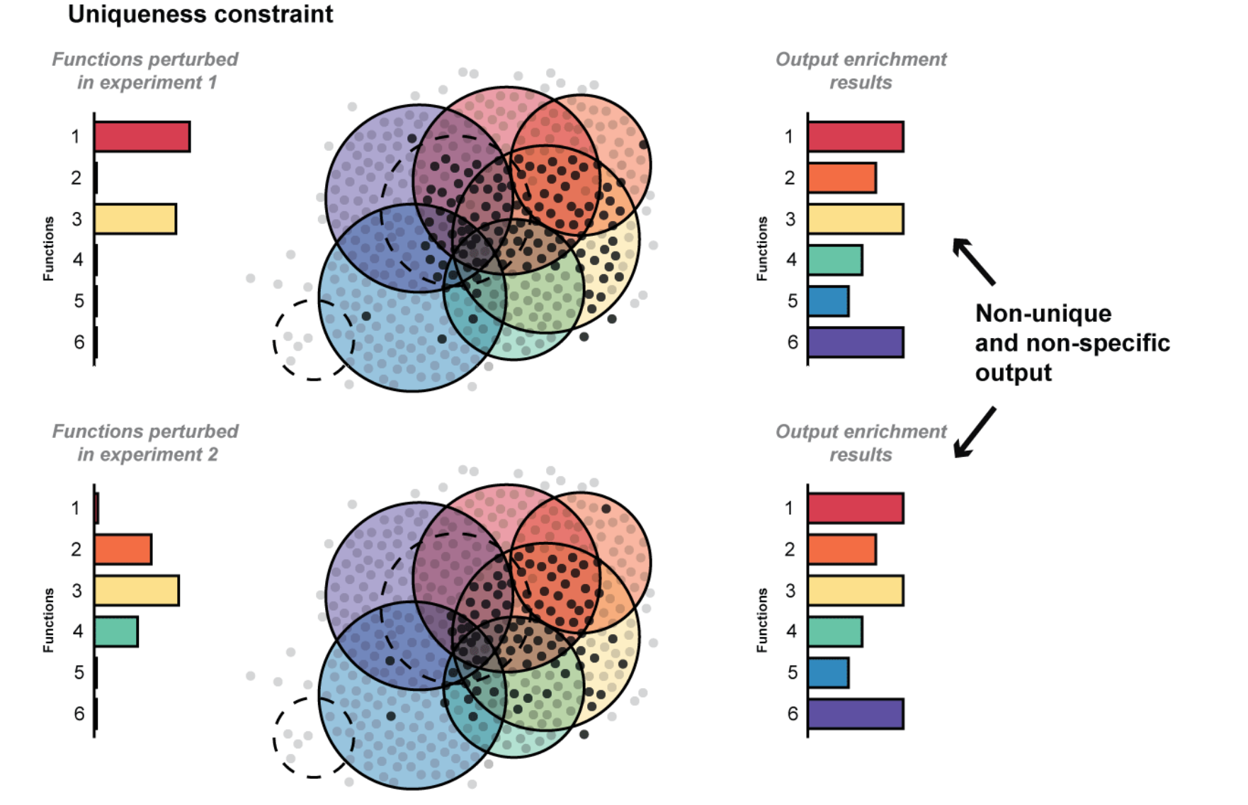
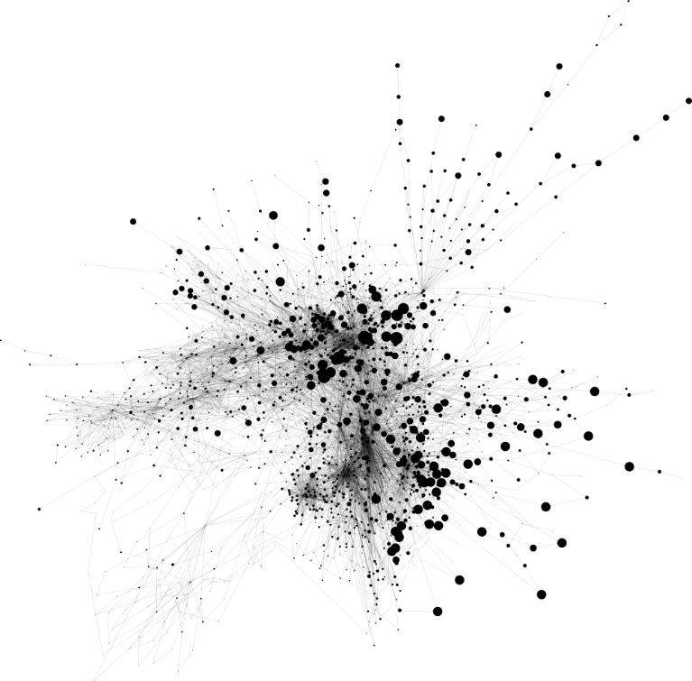
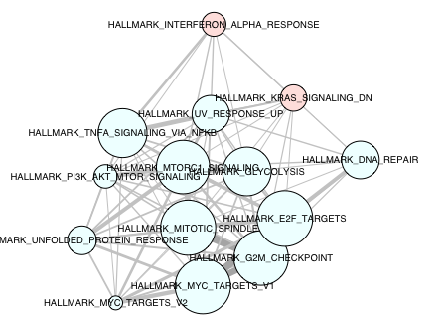
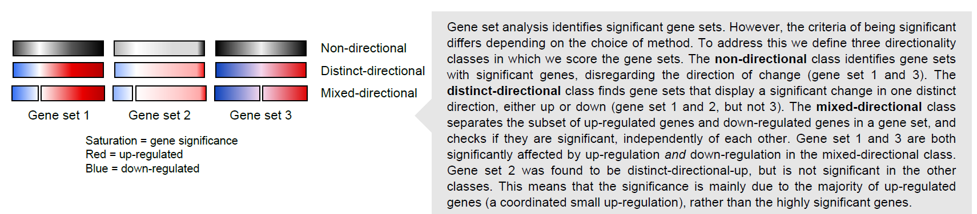
Directionality, overlap, interaction, biases…

Slide 26
Directionality of gene-sets
Disclaimer: The author of this presentation is the developer of piano

Slide 27
Gene-set overlap and interaction
Image from Enrichment Map http://dx.doi.org/10.1371/journal.pone.0013984
Gene-overlap network
High number of very overlapping gene-sets (representing a similar biological theme) can bias interpretation and take attention from other biological themes that are represented by fewer gene-sets.
Notes:
39

Slide 28
Gene-set overlap and interaction
Examples of gene-set “interactions”
High number of very overlapping gene-sets (representing a similar biological theme) can bias interpretation and take attention from other biological themes that are represented by fewer gene-sets.
Can be valuable to take gene-set interaction into account (e.g. www.sysbio.se/kiwi)
Notes:
39

Slide 29
Gene-set overlap and interaction
Images sources: Garg et al. Sci Rep 5 (2015); Gutteridge et al. PLoS ONE 8 (2013); Han et al. BMC Genomics 15 (2014)

Slide 30
When is GSA biologically meaningful?
“Heavily annotated (“multifunctional”) genes are likely to appear in genomics study results and drive the generation of biologically nonspecific enrichment results as well as highly fragile significances”
Uniqueness constraint
“To assess uniqueness, we compared the output of each algorithm when given the experimental input hit lists to that of the algorithm when the top 100 multifunctional genes was the input“
Ballouz et al. (Oct 2016) NAR. doi:10.1093/nar/gkw957

Slide 31
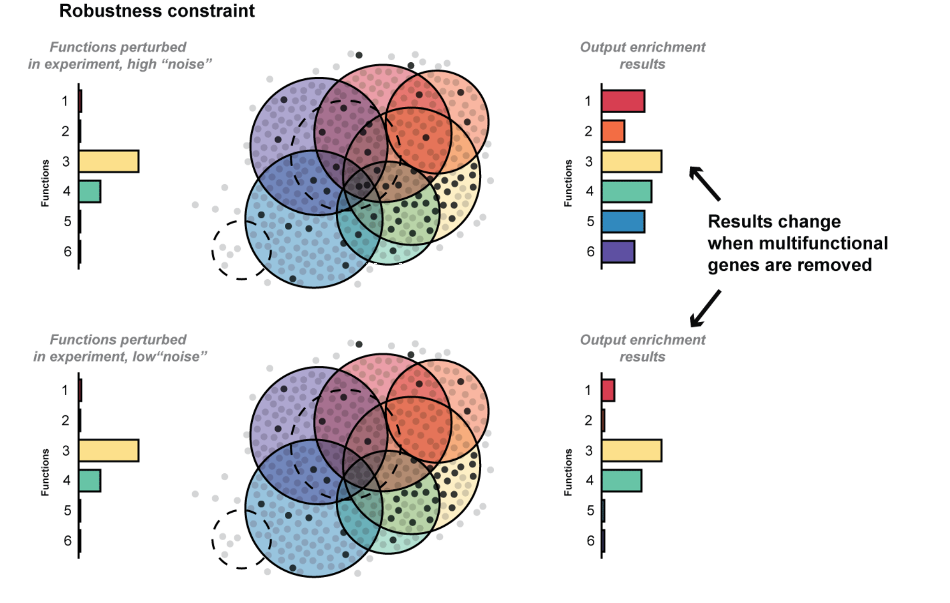
When is GSA biologically meaningful?
Robustness constraint
“Assessed robustness by removing the 5% of most multi-functional genes from the experimental hit lists”
Ballouz et al. (Oct 2016) NAR. doi:10.1093/nar/gkw957

Slide 32
Considerations when performing GSA
Bias in gene-set collections (popular domains, multifunctional genes, … )
Gene-set names can be misleading (revisit the genes!)
Consider the gene-set size, i.e. number of genes (specific or general)
Positive and negative association between genes and gene-sets makes gene-level fold-changes tricky to interpret correctly
(Typically) binary association to gene-sets, does not take into account varying levels of influence from individual genes on the process that is represented by the gene-sets
Remember to revisit the gene-level data! Are the genes significant? Are they correctly assigned to the specific gene-set?
Remember to adjust for multiple testing
Gene-set analysis is a very efficient and useful tool to interpret your genome-wide data! Just remember to critically evaluate the results ☺

Slide 33
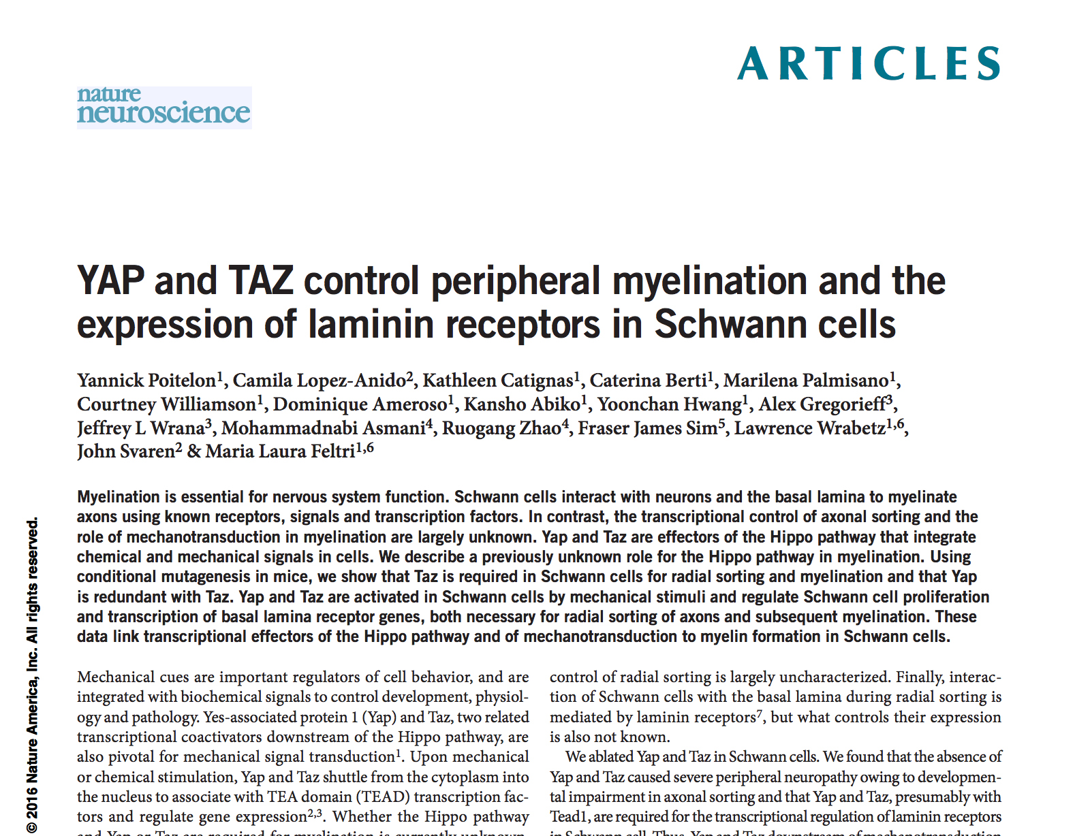
Regarding todays exercise
The same data as used yesterday (YAP/TAZ)
There are “Questions” to answer during the exercise as a self-check to see that you have understood.
Some selected questions should be handed in (will be revealed later).
Optional: Make an Rmarkdown report to document your work (demo next!)
Many questions are “open”, i.e. there is not necessarily one correct answer. The point of the questions is to get you to think about important points regarding the analysis and problems (some without a clear solution) we often encounter!
Don’t get stuck ;)
https://varemo.github.io/GSA_tutorial

Slide 34
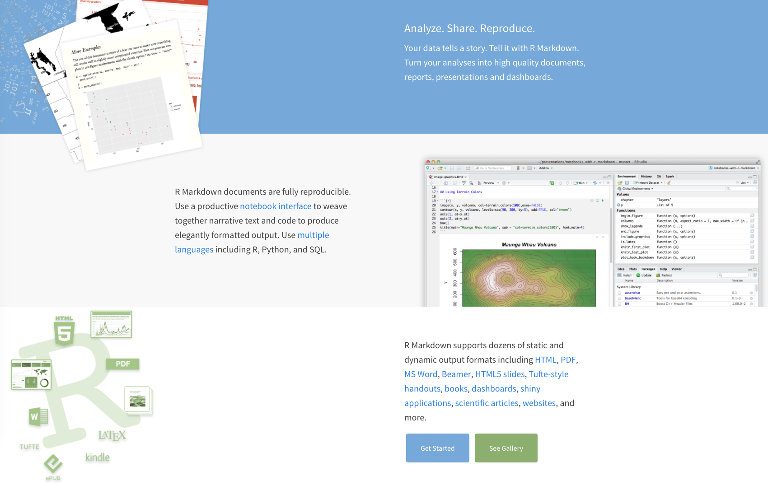
RMarkdown

